Slide 1

MBSE – Culture Change Panel
www.incose.org/IW2021

Slide 2


Digital Transformation Journey
Siloed, Analog, State
Compelling Vision/ROI
Requires
Siloed, fuzzy plan
Reality
Engaged C-Suite
Common Priorities & Plans
Delegated project
Competing Priorities & Plans
Re-invent the Company
Tech & Org RL 4.5
Digitized Siloed Work Processes
Org. RL 1.5
Years needed
Months promised and budgeted
Integrated, Digital State
Copyright Strategic Venture Planning

Slide 3
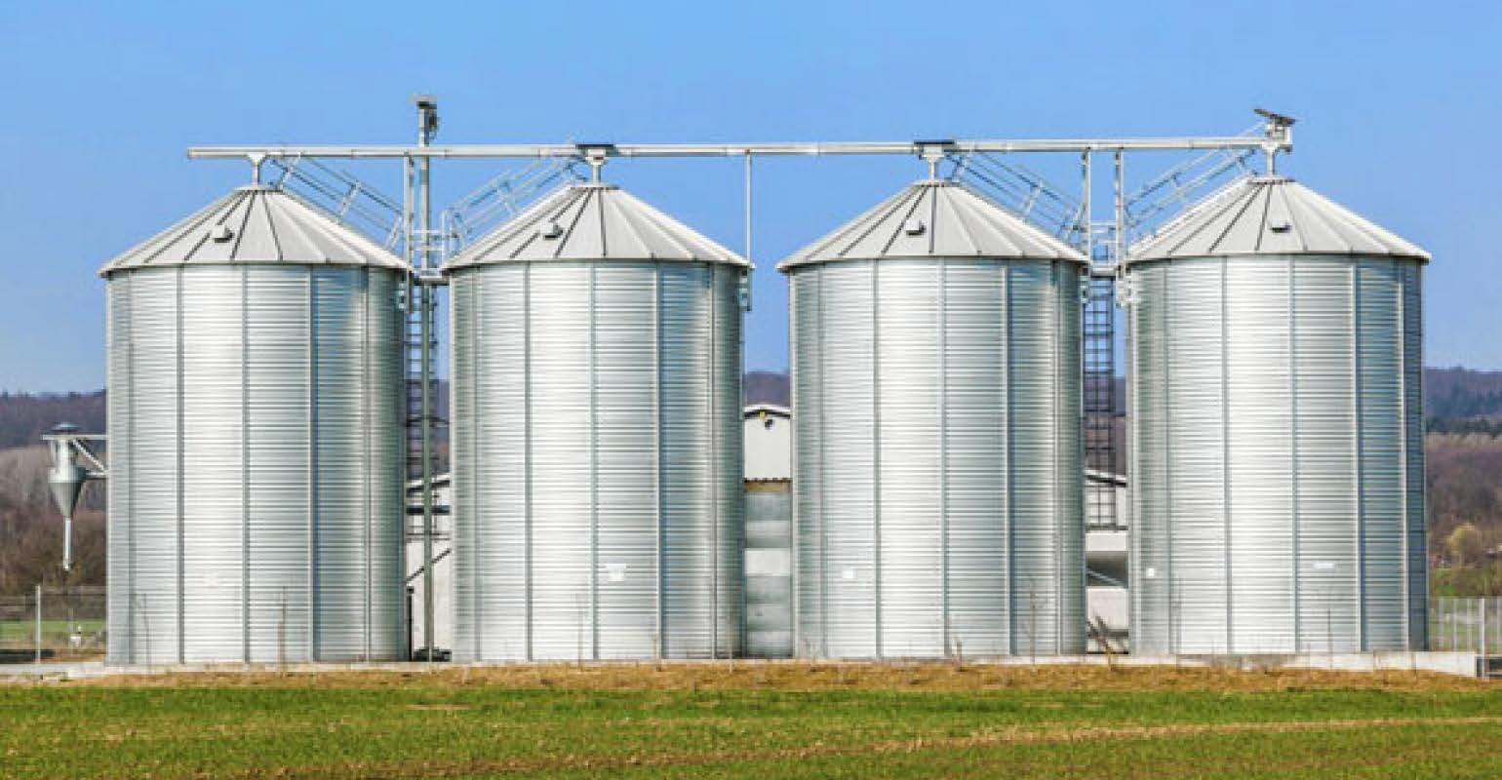
Silos
Most large enterprises are remarkably siloed Bounded rationality is the norm
Copyright Strategic Venture Planning

Slide 4
Bounded Rationality
Bounded rationality is the idea that rationality in individual’s decisions is limited by:
the tractability of the decision problem
the cognitive limitations of the mind
the time available to make the decision
the perceived or actual limits of their view or knowledge (boundaries)
some combination or all of the above
Decision-makers, in this view, act as satisficers, seeking a satisfactory (local) solution rather than an optimal (systemic) one.
Copyright Strategic Venture Planning
Source: Simon, Herbert; Models of Man

Slide 5
Bounded Rationality
3 fundamental corporate processes drive BR
STRATEGY DEVELOPMENT and DEPLOYMENT (OKRs)
OPERATIONAL TOTAL SHAREHOLDER RETURN (OTSR)
INCENTIVES
($$)

Slide 6
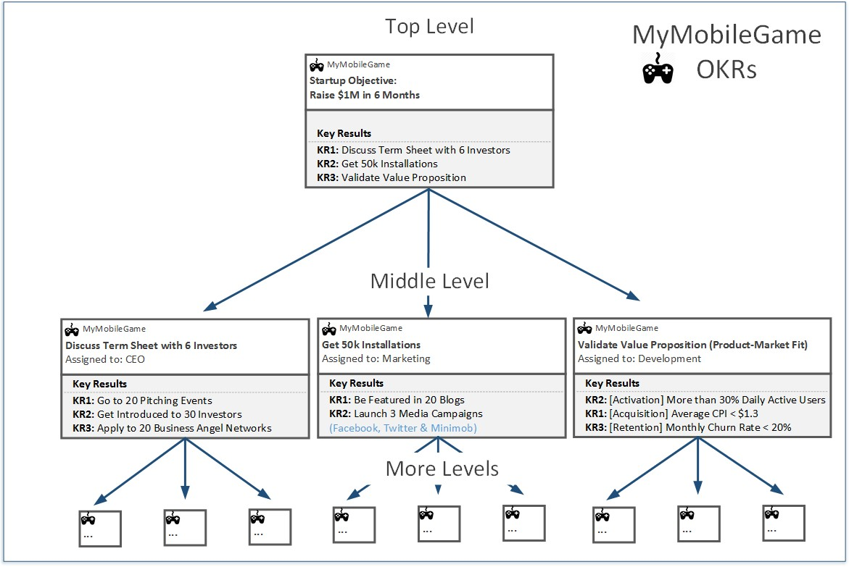
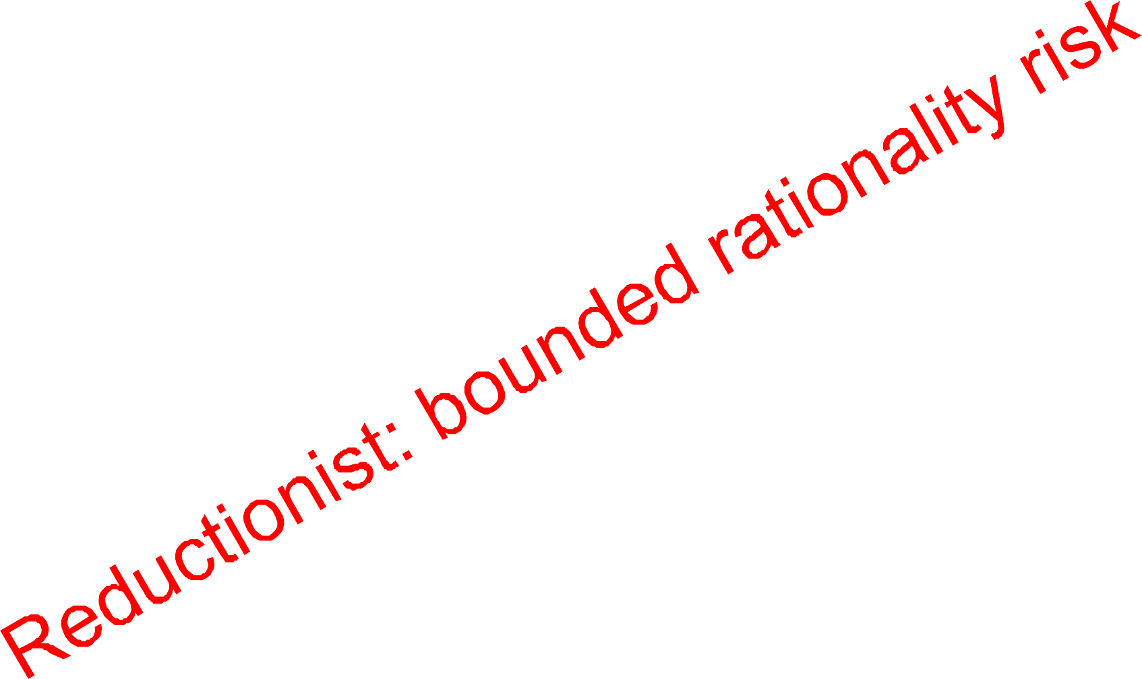
OKRs
Source: http://www.okrcoaching.com/

Slide 7












OTSR (du Pont ID)
du Pont Identity)
Sales Growth
Profit Growth
Operating TSR
Margin Improvement
Cash Flow Growth
Asset Efficiency
7

Slide 8




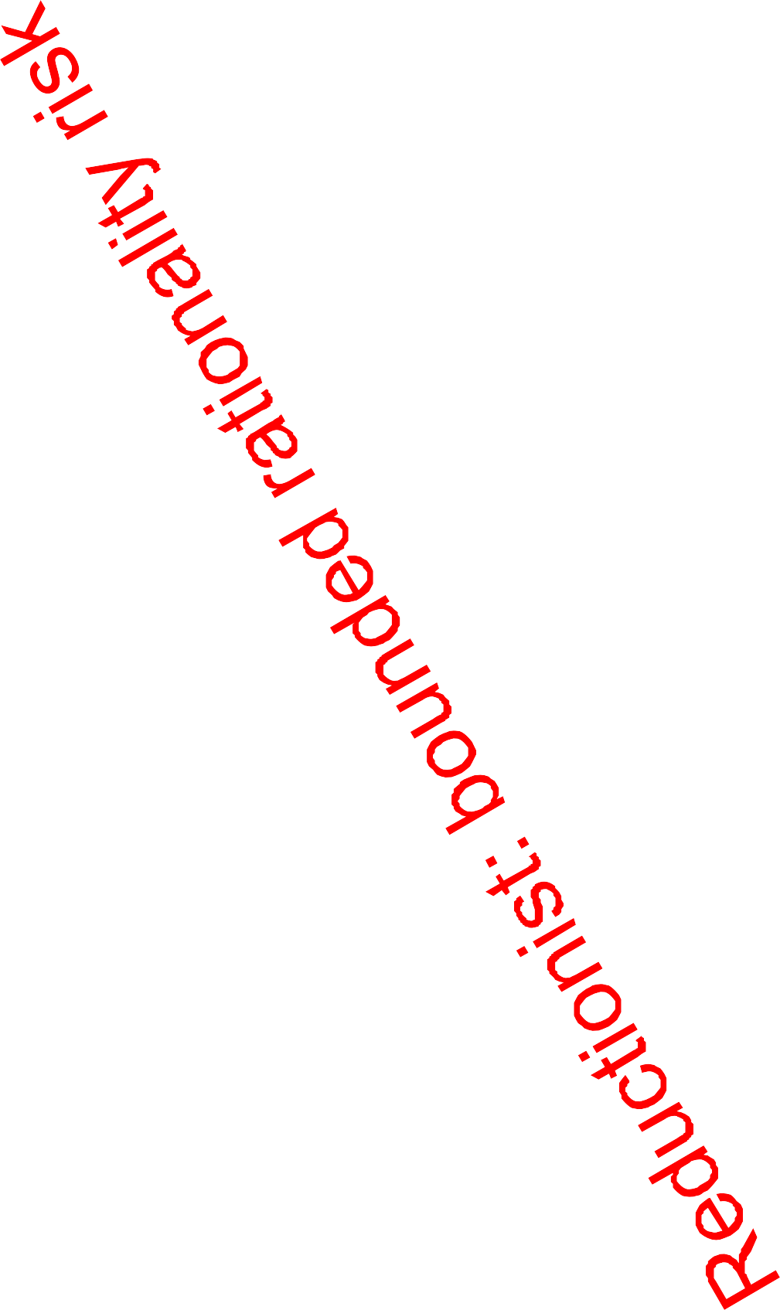





















OTSR (du Pont ID)
O
p e r a t i n g T S R
Profit
Growth
Sales
Growth
Margin
Cash Flow
Growth
Improvement
Sales
Growth
?
Asset
Efficiency
Profit
Growth
Sales
Operati ng TSR
Margin
Improvement
O
p e r a t i n g T S R
Profit
Growth
Growth
Margin
Cash Flow
Growth
Cash Flow
Growth
Improvement
Asset
?
Efficiency
Asset
Efficiency
Sales
Growth
O
p e r a t i n g T S R
Profit
Growth
Margin
Synergy?
Cash Flow
Growth
Improvement
?
Asset
Efficiency
O
p e r a t i n g T S R
Profit
Growth
Sales
Growth
Sales Growth
Margin
Cash Flow
Growth
Improvement
Profit Growth
Sales
Growth
?
Asset
Efficiency
Profit
Growth
Sales
Operatin g
TSR
Profit
Growth
Margin Improvement
Operati ng TSR
Margin
Improvement
O
p e r a t i n g T S R
Growth
Margin
Cash Flow Growth
Cash Flow
Growth
Cash Flow
Growth
Improvement
Asset
?
Efficiency
Asset Efficiency
Asset
Efficiency
Sales
Profit
Growth
O
p e r a t i n g T S R
Growth
Margin
Synergy?
Cash Flow
Growth
Improvement
?
Asset
Efficiency
O
p e r a t i n g T S R
Profit
Growth
Sales
Growth
Margin
Cash Flow
Growth
Improvement
Sales
Growth
?
Asset
Efficiency
Profit
Growth
Sales
Operati ng TSR
Margin
Improvement
O
p e r a t i n g T S R
Profit
Growth
Growth
Margin
Mathematics
vs Transformation Synergy
Cash Flow
Growth
Cash Flow
Growth
Improvement
Asset
?
Efficiency
Asset
Efficiency
Sales
Growth
O
p e r a t i n g T S R
Profit
Growth
Margin
Cash Flow
Growth
Improvement
Asset
Efficiency
8

Slide 9
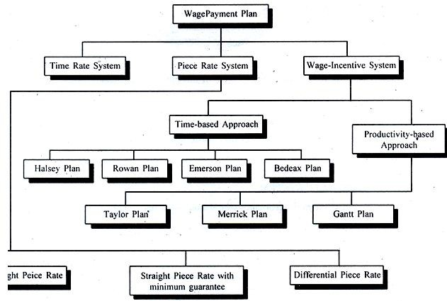
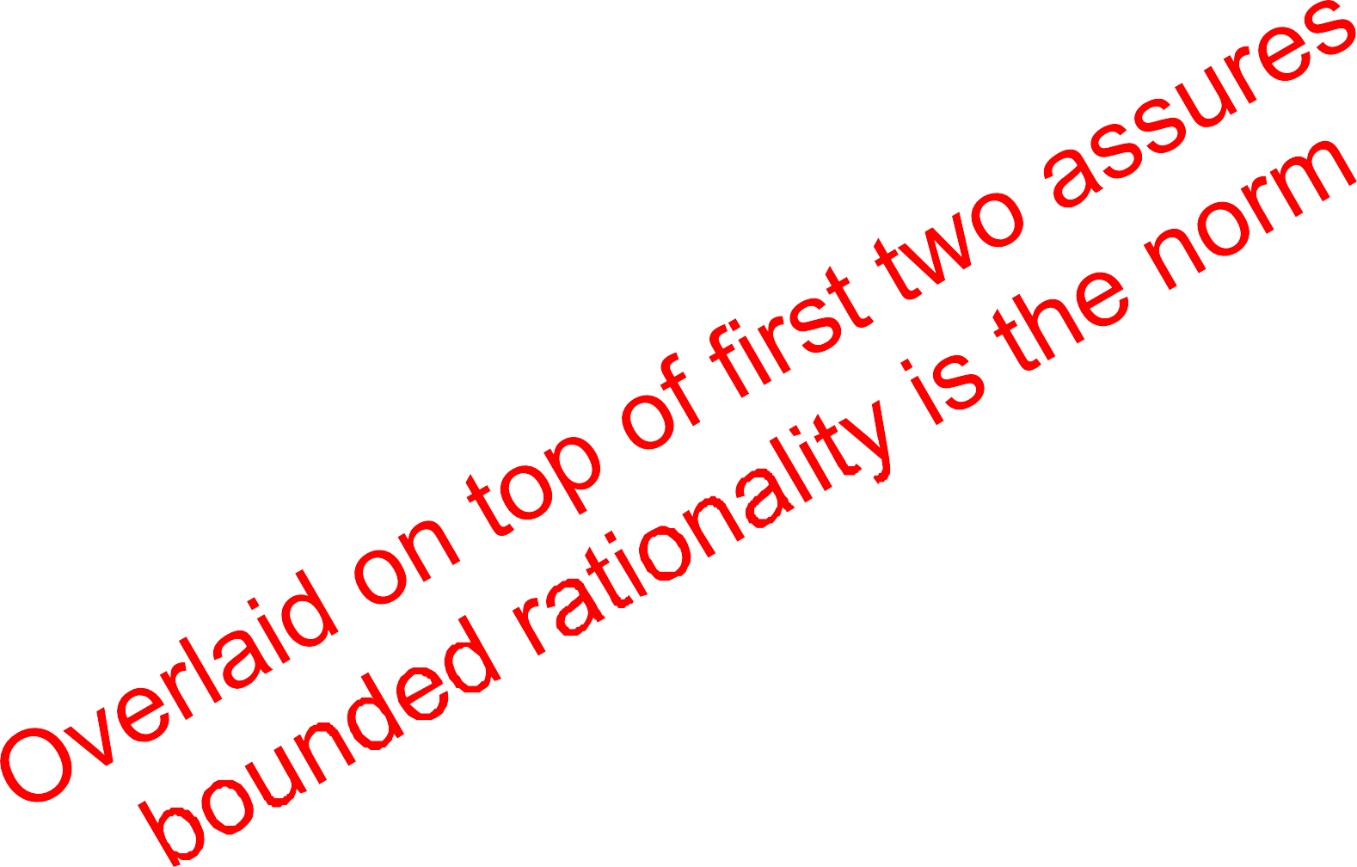
Incentives
Source: https://compensationmanagementkirimega.blogspot.com/

Slide 10
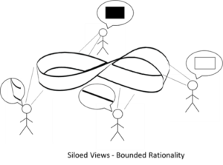
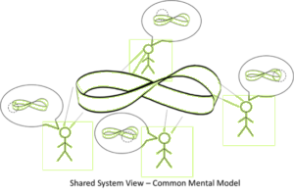
Systematic vs. Systemic
Siloed Views – Bounded Rationality
Shared System View – Common Mental Models
Copyright Strategic Venture Planning

Slide 11

Deming on Systems
The Appreciation of a system involves understanding how interactions (i.e., feedback)
between the elements of a system can result in internal restrictions
that force the elements in the system to behave as a single organisms, not as system elements (holons), that automatically seeks a steady state (bounded rationality).
It is this “steady (bounded) state” that determines the output of the system rather than the individual elements.
Thus it is the structure of the organization (read system) rather than the employees, alone, which holds the key to improving the quality of output.
“Steady State”
“The way we/I have always done it”
Copyright Strategic Venture Planning
Source: Deming; The New Economics for Industry, Government, Education

Slide 12
Three Keys (and challenges)
Must get C-Suite to think in systems (systemic and systematic)
Very rare!
Must have C-Suite support and engagement
Engagement is rare and support is usually lip-service.
Must have compelling reasons for transformation - Strategic, ROI, preferably both
Rare, usually aspirational happy talk and effort is viewed as an expense (a corporate tax at the division/local level), and therefore, resisted.
Copyright Strategic Venture Planning

Slide 13
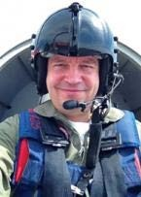
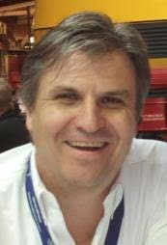
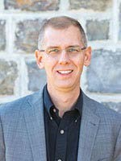
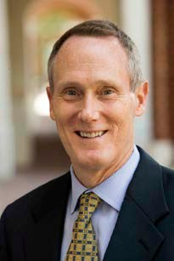
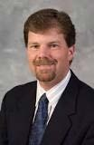
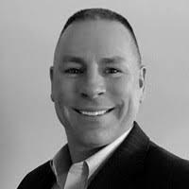
Olivier de Weck
MIT
Mark Sampson
Siemens
David Long
Vitech
Tom McDermott
SERC
Troy Peterson
SSI
Willy Donaldson
SVP/CNU

